Slide 1
PRINCIPLE OF CELLULAR COMMUNICATIONS

Slide 2
Cellular Systems-Basic Concepts
Cellular system solves the problem of spectral congestion.
Offers high capacity in limited spectrum.
High capacity is achieved by limiting the coverage area of each
BS to a small geographical area called cell.
Replaces high powered transmitter with several low power transmitters.
Each BS is allocated a portion of total channels and nearby cells are allocated completely different channels.
All available channels are allocated to small no of neighboring BS.
Interference between neighboring BSs is minimized by allocating different channels.

Slide 3
Cellular Systems-Basic Concepts
Same frequencies are reused by spatially separated BSs.
Interference between co-channels stations is kept below acceptable level.
Additional radio capacity is achieved.
Frequency Reuse-Fix no of channels serve an arbitrarily large no of subscribers

Slide 4
Frequency Reuse
used by service providers to improve the efficiency of a cellular network and to serve millions of subscribers using a limited radio spectrum
After covering a certain distance a radio wave gets attenuated and the signal falls below a point where it can no longer be used or cause any interference
A transmitter transmitting in a specific frequency range will have only a limited coverage area
Beyond this coverage area, that frequency can be reused by another transmitter.

Slide 5
Frequency Reuse
A cell = basic geographical unit of a cellular network;
is the area around an antenna where a specific frequency range is used.
when a subscriber moves to another cell, the antenna of the new cell takes over the signal transmission
a cluster is a group of adjacent cells, usually 7 cells; no
frequency reuse is done within a cluster
the frequency spectrum is divided into sub-bands and each sub- band is used within one cell of the cluster.
in heavy traffic zones cells are smaller, while in isolated zones cells are larger

Slide 6
Frequency Reuse
The design process of selecting and allocating channel groups for all of the cellular base stations within a system is called frequency reuse or frequency planning.
Cell labeled with same letter use the same set of frequencies.
Cell Shapes: Circle, Square, Triangle and Hexagon.
Hexagonal cell shape is conceptual , in reality it is irregular in shape

Slide 7
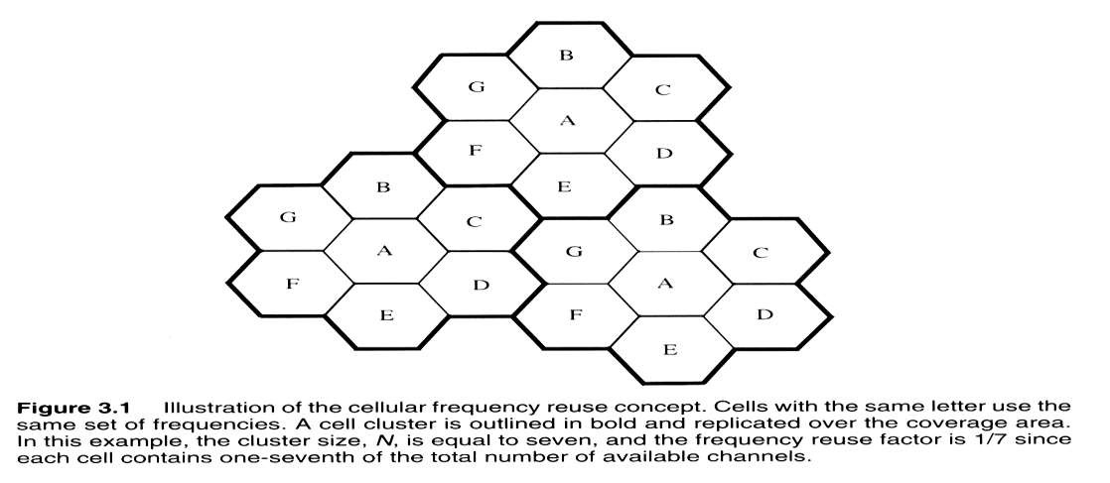

Slide 8
In hexagonal cell model, BS transmitter can be in centre of cell or on its 3 vertices.
Centered excited cells use omni directional whereas edge excited cells use directional antennas.
A cellular system having ‘S’ duplex channels, each cell is allocated ‘k’ channels(k<S).
If S channels are allocated to N cells into unique and disjoint channels, the total no of available channel is S=kN

Slide 9
N cells collectively using all the channels is called a cluster, is a
group of adjacent cells.
If cluster if repeated M times, the capacity C of system is given as C=MkN=MS
Capacity of system is directly proportional to the no of times cluster is repeated.
Reducing the cluster size N while keeping the cell size constant, more clusters are required to cover the given area and hence more capacity.
Co-channel interference is dependent on cluster size, large cluster size less interference and vice versa.

Slide 10
The Frequency Reuse factor is given as 1/N, each cell is assigned 1/N of total channels.
Lines joining a cell and each of its neighbor are separated by multiple of 60°,certain cluster sizes and cell layout possible
Geometery of hexagon is such that no of cells per cluster i.e N, can only have values which satisfy the equation N=i2+ij+j2
N, the cluster size is typically 4, 7 or 12.
In GSM normally N =7 is used. i and j are integers, for i=3 and j=2 N=19.

Slide 11
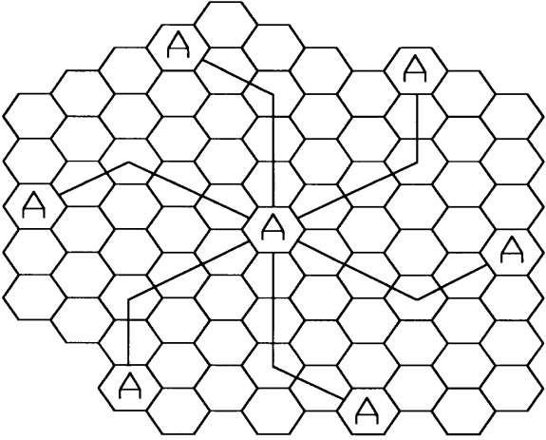
Locating co-channel Cell

Slide 12
Channel Assignment Strategies
A scheme for increasing capacity and minimizing interference is required.
CAS can be classified as either fixed or dynamic Choice of CAS impacts the performance of system.
In Fixed CA each cell is assigned a predetermined set of voice channels
Any call attempt within the cell can only be served by the unused channel in that particular cell
If all the channels in the cell are occupied, the call is blocked.
The user does not get service.
In variation of FCA, a cell can borrow channels from its neighboring cell if its own channels are full.

Slide 13
Dynamic Channel Assignment
Voice channels are not allocated to different cells permanently.
Each time a call request is made, the BS request a channel from the MSC.
MSC allocates a channel to the requesting cell using an algorithm that takes into account likelihood of future blocking
The reuse distance of the channel ( should not cause interference)
Other parameters like cost
To ensure min QoS, MSC only allocates a given frequency if that frequency is not currently in use in the cell or any other cell which falls within the limiting reuse distance.
DCA reduce the likelihood of blocking and increases capacity
Requires the MSC to collect realtime data on channel occupancy and traffic distribution on continous basis.

Slide 14
Hand-off
Mobile moves into a different cell during a conversation, MSC transfers the call to new channel belonging to new BS
Handoff operation involves identifying the new BS and allocation of voice and control signal to channels associated with new BS
Must be performed successfully, infrequently and impercitable to user
To meet these requirements an optimum signal level must be defined to initiate a handoff.
Min usuable signal for acceptable voice qualtiy -90 to -100 dBm
A slight higher value is used as threshold

Slide 15
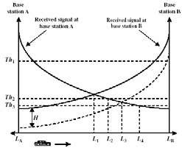
By looking at the variations of signal strength from either BS it is possible to decide on the optimum area where handoff can take place

Slide 16
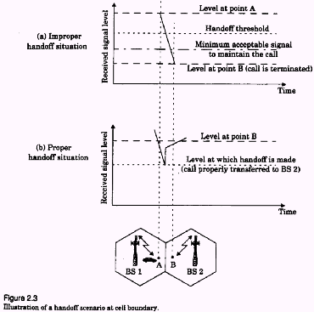

Slide 17
Hand-off strategies
Handoff is made when received signal at the BS falls below a
certain threshold
During handoff: to avoid call termination, safety margin should
exist and should not be too large or small
^{Δ=Power_}handoff ^{– Power_}min usable
Large Δ results in unecesarry handoff and for small Δ unsufficient time to complete handoff, so carefully chosen to meet the requirements.
Fig a, handoff not made and signal falls below min acceptable
level to keep the channel active.
Can happen due to excessive delay by MSC in assigning
handoff, or when threshold Δ is set to small.
Excessive delay may occur during high traffic conditions due to computional
loading or non avialablilty of channels in nearby cells

Slide 18
Hand-off
In deciding when to handoff , it is important to ensure that the drop in
signal level is not due to momentary fading.
In order to ensure this the BS monitors the signal for a certain period of
time before initiating a handoff
The length of time needed to decide if handoff is necessary depends on
the speed at which the mobile is moving

Slide 19
Hand-off strategies
In 1st generation analog cellular systems, the signal strength
measurements are made by the BS and are supervised by the MSC.
A spare Rx in base station (locator Rx) monitors RSS of RVC's in
neighboring cells
Tells Mobile Switching Center about these mobiles and their channels
Locator Rx can see if signal to this base station is significantly better than to the host base station
MSC monitors RSS from all base stations & decides on handoff

Slide 20
Hand-off strategies
In 2nd generation systems Mobile Assisted Handoffs (MAHO)are used
In MAHO, every MS measures the received power from the surrounding BS and continually reports these values to the corresponding BS.
Handoff is initiated if the signal strength of a neighboring BS exceeds
that of current BS
MSC no longer monitors RSS of all channels
reduces computational load considerably enables much more rapid and efficient handoffs imperceptible to user
8866

Slide 21
Soft Handoff
CDMA spread spectrum cellular systems provides a unique handoff
capability
Unlike channelized wireless systems that assigns different radio channel during handoff (called hard handoff), the spread spectrum MS share the same channel in every cell
The term handoff here implies that a different BS handles the radio
communication task
The ability to select between the instantaneous received signals from
different BSs is called soft handoff

Slide 22
Inter system Handoff
If a mobile moves from one cellular system to a different system
controlled by a different MSC, an inter-system handoff is necessary
MSC engages in intersystem handoff when signal becomes weak in a given cell and MSC cannot find another cell within its system to transfer the on-going call
Many issues must be resolved
Local call may become long distance call
Compatibility between the two MSCs

Slide 23
Prioritizing Handoffs
Issue: Perceived Grade of Service (GOS) – service quality as
viewed by users
“quality” in terms of dropped or blocked calls (not voice quality)
assign higher priority to handoff vs. new call request
a dropped call is more aggravating than an occasional blocked call
Guard Channels
% of total available cell channels exclusively set aside for handoff
requests
makes fewer channels available for new call requests
a good strategy is dynamic channel allocation (not fixed)
adjust number of guard channels as needed by demand
so channels are not wasted in cells with low traffic

Slide 24
Prioritizing Handoffs
Queuing of Handoff Requests
use time delay between handoff threshold and minimum useable signal
level to place a blocked handoff request in queue
a handoff request can "keep trying" during that time period, instead of
having a single block/no block decision
prioritize requests (based on mobile speed) and handoff as needed calls will still be dropped if time period expires

Slide 25
Practical Handoff Considerations
Problems occur because of a large range of mobile velocities
pedestrian vs. vehicle user
Small cell sizes and/or micro-cells → larger # handoffs
MSC load is heavy when high speed users are passed between very small cells
Umbrella Cells
use different antenna heights and Tx power levels to provide large and
small cell coverage
multiple antennas & Tx can be co-located at single location if necessary
(saves on obtaining new tower licenses)
large cell → high speed traffic → fewer handoffs small cell → low speed traffic
example areas: interstate highway passing through urban center, office
park, or nearby shopping mall

Slide 26
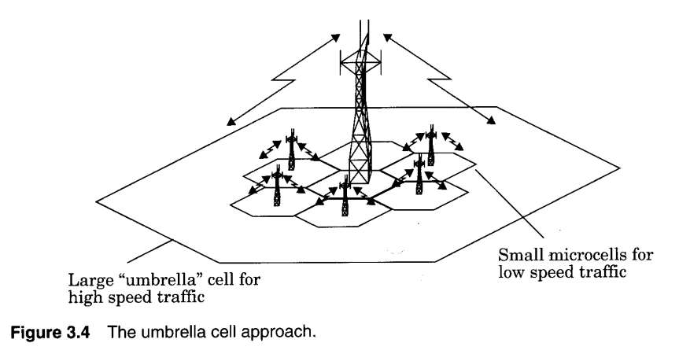
Umbrella Cells

Slide 27
Typical handoff parameters
Analog cellular (1st generation)
threshold margin △ ≈ 6 to 12 dB
total time to complete handoff ≈ 8 to 10 sec
Digital cellular (2nd generation)
total time to complete handoff ≈ 1 to 2 sec
lower necessary threshold margin △ ≈ 0 to 6 dB
enabled by mobile assisted handoff

Slide 28
Reuse Ratio:
For hexagonal cell reuse distance is given by D=R(√3N)
Where R is cell size or cell radius and N is cluster size
D increases as we increase N Reuse factor is given by Q=D/R=(√3N)

Slide 29
Interference
Goals for this section Co-Channel
Adjacent Channel
How to calculate signal to interference ratio

Slide 30
Interference
Interference is major limiting factor in the performance of cellular radio. It limits the capacity and increases the no of dropped calls.
Sources of interference include Another mobile in same cell
A call in progress in a neighboring cell
Other BSs operating in the same frequency band

Slide 31
Effects of Interference
Interference in voice channels causes
Crosstalk Noise in background
Interference in control channels causes Error in digital signaling, which causes
Missed calls
Blocked calls Dropped calls

Slide 32
Interference
Two major types of Interferences
Co-channel Interference (CCI)
Adjacent channel Interference (ACI)
CCI is caused due to the cells that reuse the same frequency set. These
cells using the same frequency set are called Co-channel cells
ACI is caused due to the signals that are adjacent in frequency

Slide 33
Co-channel Interference
Increase base station Tx power to improve radio signal reception?
will also increase interference into other co-channel cells by the same
amount
no net improvement
Separate co-channel cells by some minimum distance to provide sufficient isolation from propagation of radio signals?
if all cell sizes, transmit powers, and coverage patterns ≈ same → co-channel interference is independent of Tx power

Slide 34
Co-channel Interference
co-channel interference depends on:
R : cell radius
D : distance to base station of nearest co-channel cell where D=R(√3N)
if D/R ↑ then spatial separation relative to cell coverage area ↑
improved isolation from co-channel RF energy
Q = D / R : co-channel reuse ratio
hexagonal cells → Q = D/R = √3N
Smaller value of Q provides larger capacity, but higher CCI
Hence there is tradeoff between capacity and interference.
small Q → small cluster size → more frequency reuse → larger
system capacity
small Q → small cell separation → increa₁se₀d₀ CCI

Slide 35
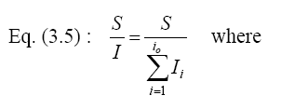
Signal to Interference ratio S/I
The Signal-to-Interference (S/I) for a mobile is
S is desired signal power ,I_{i} : interference power from i^{th} co-channel cell
The average received power at distance d is
P_{r}=Po (d/d_{o})^{-n}
The RSS decays as a power law of the distance of separation between
transmitter and receiver
Where P_{o} is received power at reference distance d_{o} and n is the path
loss exponent and ranges between 2-4
If D_{i} is the distance of i^{th} interferer, the received power is proportional to
(D_{i})^{-n}

Slide 36
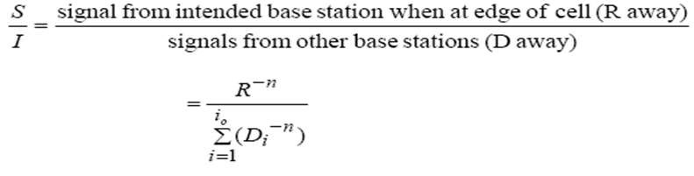
Signal to Interference ratio S/I
The S/I for mobile is given by
S
_{R}− n
₌ (D / R)^{n}
₌ ( 3N )^{n}
_{= Q}4
=
∑(D_{i} )
i=1
I
i₀ =6
−n
6
6
6
With only the first tier(layer of) equidistant interferers.
For a hexagonal cluster size, which always have 6 CC cell in first tier

Slide 37
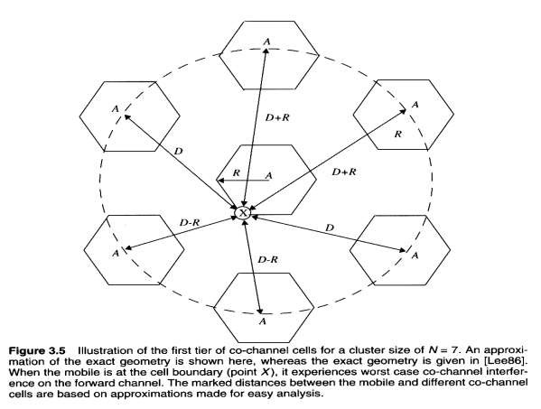


Signal to Interference ratio S/I
The MS is at cell
boundary
The aproximate S/I is given by, both in terms of R and D, along with channel reuse ratio Q

Slide 38
Example S/I
Examples for Problem 2.3
TDMA can tolerate S/I = 15 dB
What is the optimal value of N for omni-directional antennas? Path loss = 4. Co-
channel Interference
cluster size N =7 (choices 4,7,12)
path loss exponent (means)n=4
co-channel reuse ratio Q=sqrt(3N)=4.582576 Ratio of distance to radius Q=D/R=4.582576
number of neighboring cells i_{o}=6 # of sides of hexagon
signal to interference ratio S/I= (D/R)^{^n} / i_{o} =73.5
convert to dB, S/I=10log(S/I) =18.66287dB
S/I is greater than required, it wil₁l₀w₄ ork.

Slide 39
Example S/I
cluster size N=4 (choices 4,7,12) path loss exponent (means) n=4
co-channel reuse ratio Q= sqrt(3N)=3.464102 Ratio of distance to radius Q=D/R=3.464102
number of neighboring cells io=6 ,# of sides of hexagon
signal to interference ratio S/I= (D/R)^{^n} / i_{o} =24
convert to dB, S/I= 10log(S/I)=13.80211dB
S/I is less than required, it will not work!
cluster size N=7 path loss exponent n=3 Q=sqrt(3N)=4.582576
number of neighboring cells io= 6, # of sides of hexagon
signal to interference ratio=S/I= (D/R)^{^n} / i_{o} =16.03901 convert to dB, S/I=10log(S/I)=12.05178dB ₁₀₅ S/I is less than required, it will not work!

Slide 40
Adjacent Channel Interference
Results from imperfect receiver filters, allowing nearby frequencies to leak
into pass-band.
Can be minimized by careful filtering and channel assignments.
Channels are assigned such that frequency separations between
channels are maximized.
For example, by sequentially assigning adjacent bands to different cells
Total 832 channels, divided into two groups with 416 channels each.
Out of 416, 395 are voice and 21 are control channels.
395 channels are divided into 21 subsets, each containing almost 19 channels,
with closet channel 21 channels away
If N=7 is used, each cell uses 3 subsets, assigned in such a way that each
channel in a cell is 7 channels away.

Slide 41
1 2 3 4 5 6 7 8 9 10¹¹121314
freq
2
B ₉
4
^{G} 11
5
1
^{C} 12
A ₈
6
F 13
7
^{D}14
3
^{E}10
Frequency Planning/Channel Assignment

Slide 42
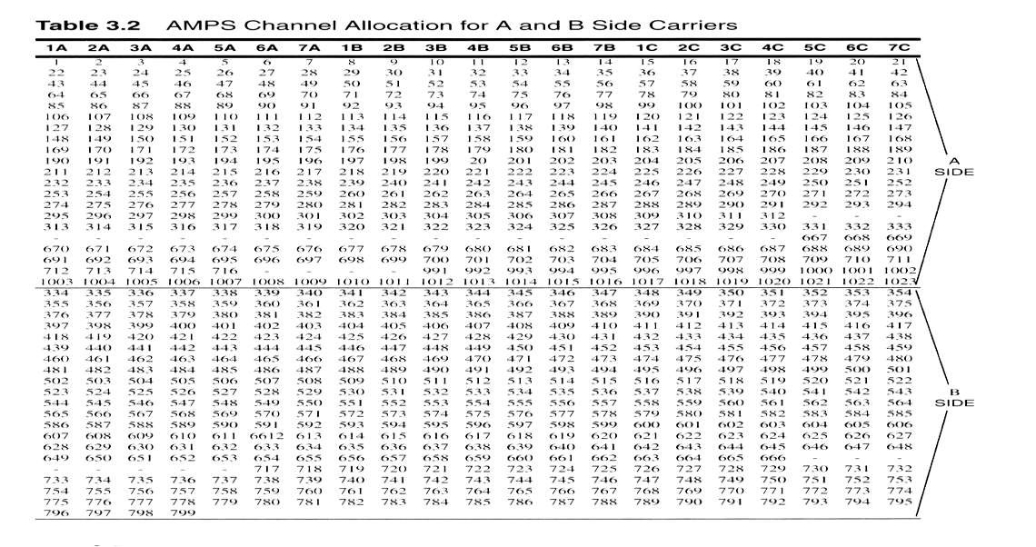

Slide 43
Improving Capacity
As demand for service increases, system designers have to provide more
channel per unit coverage area
Common Techniques are: Cell Splitting, Sectoring and Microcell Zoning
Cell Splitting increases the number of BS deployed and allows an orderly
growth of the cellular system
Sectoring uses directional antennas to further control interference
Micro cell Zoning distributes the coverage of cell and extends the cell boundary to hard-to-reach areas

Slide 44
Cell Splitting
Cell splitting is the process of subdividing a congested cell into smaller
cells with
their own BS
a corresponding reduction in antenna height
a corresponding reduction in transmit power
Splitting the cell reduces the cell size and thus more number of cells
have to be used
For the new cells to be smaller in size the transmit power of these cells
must be reduced.
Idea is to keep Q=D/R constant while decreasing R
More number of cells ► more number of clusters ► more channels ►high
capacity

Slide 45
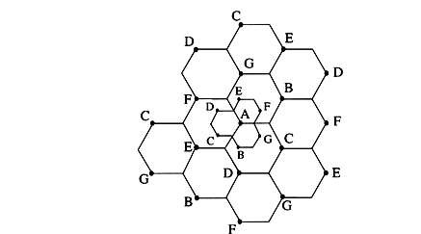
Cells are split to add channels with
no new spectrum usage

Slide 46
Example S/I
cluster size N=4 (choices 4,7,12) path loss exponent (means) n=4
co-channel reuse ratio Q= sqrt(3N)=3.464102 Ratio of distance to radius Q=D/R=3.464102
number of neighboring cells io=6 ,# of sides of hexagon
signal to interference ratio S/I= (D/R)^{^n} / i_{o} =24
convert to dB, S/I= 10log(S/I)=13.80211dB
S/I is less than required, it will not work!
cluster size N=7 path loss exponent n=3 Q=sqrt(3N)=4.582576
number of neighboring cells io= 6, # of sides of hexagon
signal to interference ratio=S/I= (D/R)^{^n} / i_{o} =73.334
convert to dB, S/I=10log(S/I)=18.65dB
S/I is less than required, it will work!

Slide 47
Cell Splitting-Power Issues
Suppose the cell radius of new cells is reduced by half
What is the required transmit power for these new cells??
Pr[at old cell boundary]=Pt1R^{-n}
Pr[at new cell boundary]= Pt2(R/2) ^{–n}
where Pt1and Pt2are the transmit powers of the larger and smaller cell
base stations respectively, and n is the path loss exponent.
So, Pt2= Pt1/2^{n}
If we take n=3 and the received powers equal to each other, then
Pt2=Pt1/8
In other words, the transmit power must be reduced by 9dB in order to fill in
the original coverage area while maintaining the S/I requirement

Slide 48
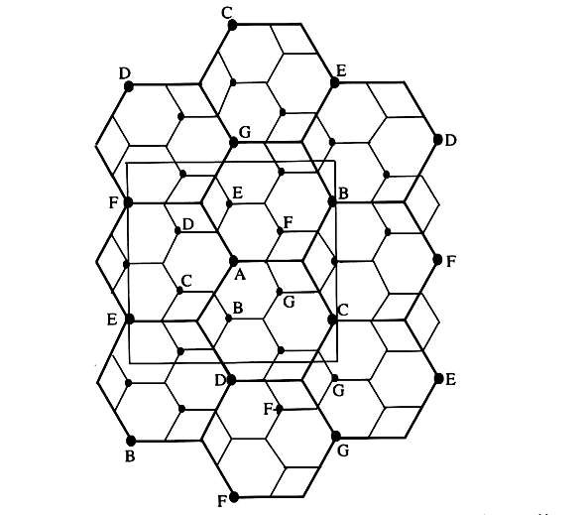
Illustration of cell splitting in 3x3 square
centered around base station A

Slide 49
Cell Splitting
In practice not all the cells are split at the same time hence different size cells
will exist simultaneously.
In such situations, special care needs to be taken to keep the distance between co-channel cells at the required minimum, and hence channel assignments become more complicated.
To overcome handoff problem:
Channels in the old cell must be broken down into two channel groups, one for smaller cell
and other for larger cell
The larger cell is usually dedicated to high speed traffic so that handoffs occur less
frequently
At start small power group has less channels and large power group has large no of channels, at maturity of the system large power group does not have any channel

Slide 50
Umbrella Cells

Slide 51
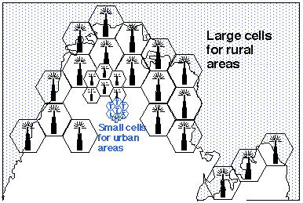
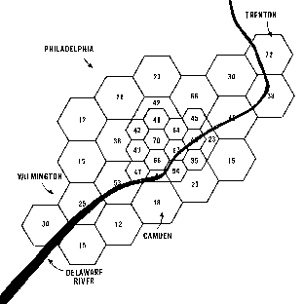

Slide 52
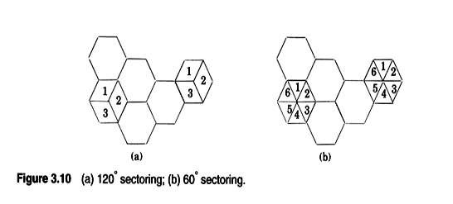
Sectoring
In this approach
first SIR is improved using directional antennas,
capacity improvement is achieved by reducing the number of cells in a cluster thus increasing frequency reuse
The CCI decreased by replacing the single omni-directional antenna by several
directional antennas, each radiating within a specified sector

Slide 53
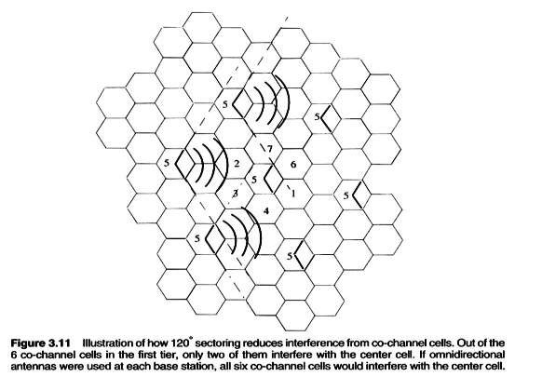
Sectoring
A directional antenna transmits to and receives from only a fraction of total of the co-channel cells. Thus CCI is reduced

Slide 54
Problems with Sectoring
Increases the number of antennas at each BS
Decrease in trunking efficiency due to sectoring(dividing the bigger
pool of channels into smaller groups)
Increase number of handoffs(sector-to sector)
Good news:Many modern BS support sectoring and related handoff without help of MSC

Slide 55
Microcell Zone Concept
The Problems of sectoring can be addressed by Microcell Zone
Concept
A cell is conceptually divided into microcells or zones Each microcell(zone) is connected to the same base
station(fiber/microwave link)
Doing something in middle of cell splitting and sectoring by extracting
good points of both
Each zone uses a directional antenna Each zone radiates power into the cell.
MS is served by strongest zone
As mobile travels from one zone to another, it retains the same channel,
i.e. no hand off
The BS simply switches the channel to the next zone site

Slide 56
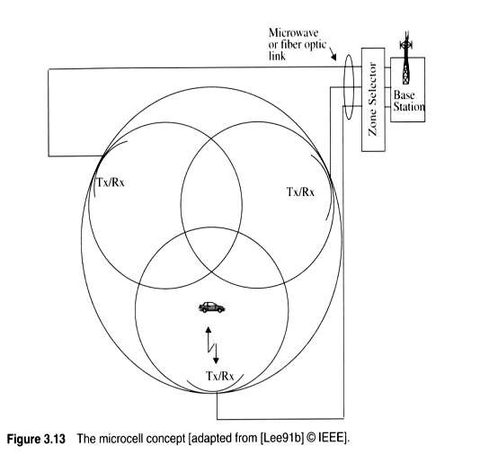
Micro Zone Cell Concept

Slide 57
Microcell Zone Concept
Reduced Interference (Zone radius is small so small and directional
antennas are used).
Decrease in CCI improves the signal quality and capacity.
No loss in trunking efficiency (all channels are used by all cells).
No extra handoffs.
Increase in capacity (since smaller cluster size can be used).

Slide 58
Repeaters for Range Extension
Useful for hard to reach areas
Buildings Tunnels Valleys
Radio transmitters called Repeaters can be used to provide coverage in
these area
Repeaters are bi-directional Rx signals from BS Amplify the signals
Re-radiate the signals
Received noise and interference is also re-radiated

Slide 59
Assignment
Attempt Qn1 – 4, 8 – 12 from chapter two of the Book “Wireless communications 2nd Edition by Theodore S. Rappaport”

Slide 60
THANK YOU

